Slide 1


WHEELCHAIR MOVEMENT CONTROL WITH TONGUE DRIVE ASSISTIVE TECHNOLOGY USING IOT
PRESENTED BY:
1. ABINAYAA.A (210918106003)
2. DIMPLE VINCIA SELET.R.R (210918106015)
3. KAVITHA SRI.G (210918106032)
GUIDED BY:
Dr.K.R.SHANTHY (HOD/Department of ECE)

Slide 2
ABSTRACT
Tongue Drive system (TDS) is a tongue-operated unobtrusive wireless assistive technology, which can potentially provide people with severe disabilities.
It translates users intentions into control commands by detecting and classifying their voluntary tongue motion utilizing a small permanent magnet, secured on the tongue.
Array of magnetic sensors mounted on a headset outside the mouth and orthodontic brace inside.
We have to developed customized interface circuitry and implemented four control strategies to drive a Powered Wheel Chair.
Keywords -Tongue drive system (TDS), RF communication.

Slide 3
INTRODUCTION
The paper aims in designing customized interface circuitry by implementing four control strategies to move a wheel chair.
TDS is an assistive technology that enables individuals to maneuver a wheelchair using simple tongue movements and it can be operated by individuals.
The purpose of the present study is to develop a wheel chair for the Quadriplegics which assists them to control the movement of wheelchair through their tongue motion using a Hall effect sensors with one encoder and one decoder for controlling it safely.
The magnetic sensors are nothing but hall effect sensors.
A hall effect sensor is a transducer that varies its output voltage in response to changes in magnetic field.

Slide 4
EXISTING SYSTEM
The system uses an array of magnetic sensors to wirelessly track tongue movements by detecting the position and orientation of a permanent magnetic tracer secured on the tongue.
The tongue movements can be translated into various commands for computer access, navigation.
Tongue drive system (TDS) is to help people with severe disabilities and provide them an independent life.
The current Tongue Drive System prototype consists of four magneto-inductive sensors mounted on a helmet that have been demonstrated.

Slide 5
PROPOSED SYSTEM
Tongue Drive system (TDS) is a tongue-operated unobtrusive wireless assistive technology, which can potentially provide people with severe disabilities.
It translates users intentions into control commands by detecting and classifying their voluntary tongue motion utilizing a small permanent magnet, secured on the tongue, and an array of magnetic sensors mounted on a headset outside the mouth and orthodontic brace inside.
We have developed customized interface circuitry and implemented four control strategies to drive a powered wheel chair (PWC) using an external TDS prototype.
This Project consists of two Microcontroller Units, Wheel chair and Hall Effect sensors and wireless communication through RF. Wheel chair is made up of High torque Geared DC Motors, the Motors Directions can be changed through the set of instructions given from the microcontroller and the action of these Instructions is already loaded into the Microcontroller using Embedded C programming.

Slide 6
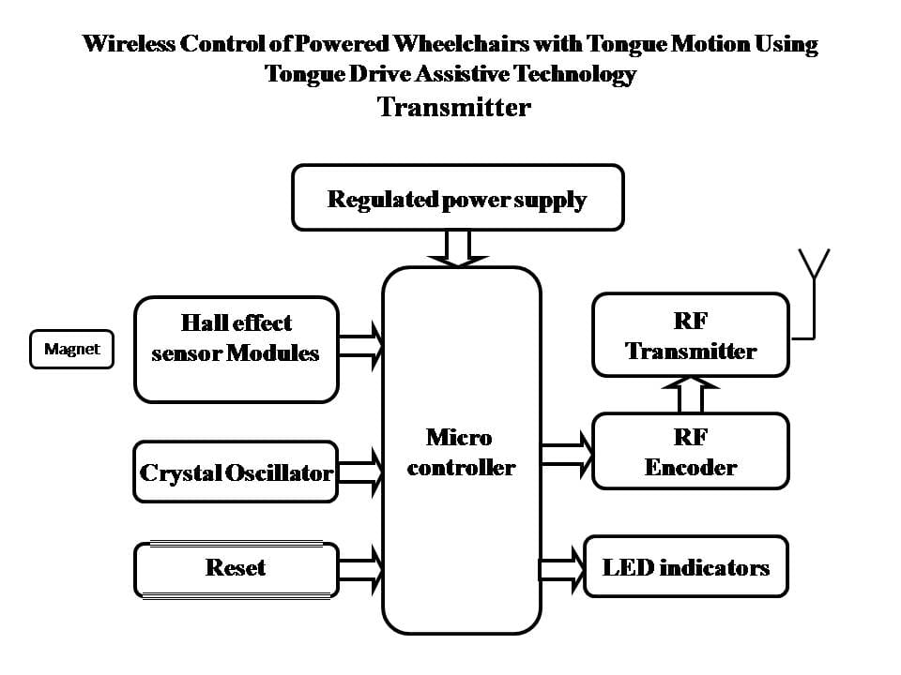
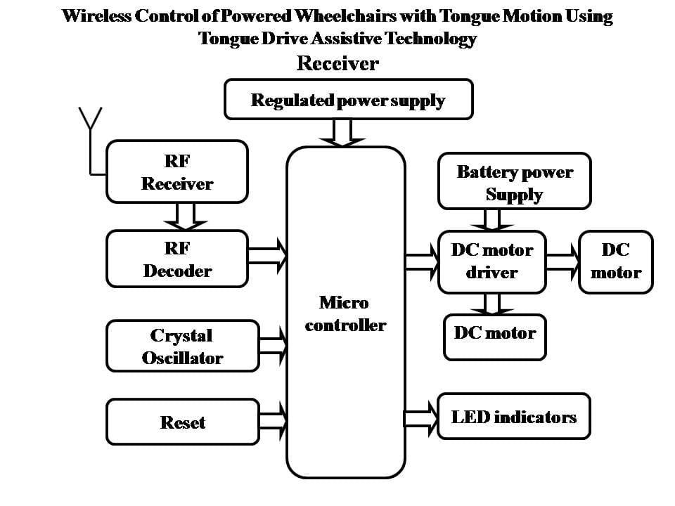
Block Diagram
80C51
80C51

Slide 7
Transmitter & Receiver
The control system consists of Hall Effect sensors and Microcontroller.
Microcontroller collects data from the sensors and transmits to the encoded data through the RF transmitter.
At receiver end RF receiver receives the data through the decoder and fed as input to the microcontroller.
The controller performs the corresponding actions (i.e.) wheel chair movement.
This Project consists of two Microcontroller Units, Wheel chair and Hall Effect sensor and wireless communication through RF.
Wheel chair is made up of High torque Geared DC Motors, the Motor Directions can be changed through the set of instructions given from the Hall Effect sensor and the action of these Instructions is already loaded into the Microcontroller using Embedded C programming.
The RF receiver provides the information to the microcontroller from RF transmitter and the controller judges whether the instruction is right or left movement based on the tongue movement and controls the direction.

Slide 8
Softwares used
Keil µ Vision5 software for embedded C programming.

Slide 9
HardwareS Used
Regulated Power Supply
Hall Effect Sensors
Microcontroller
RF Transmitter
RF Receiver
Motor driver
High Torque Geared DC Motors

Slide 10
Power Supply

Slide 11
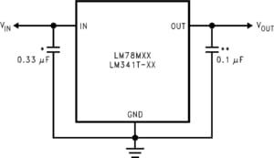
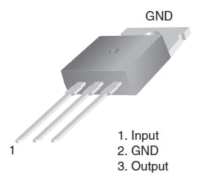
Power Supply
An AC to DC adaptor as been used to get DC input for the mother board. In mother board, we have developed a 5V regulator circuit, which is needed for microcontroller as supply voltage.
IR transmitters are also connected to 5V supply, so that they always transmit high signal. LM7805 is used for 5V regulated supply.

Slide 12
Features
Output current in excess of 0.5A
No external components
Internal thermal overload protection
Internal short circuit current-limiting
Output transistor safe-area compensation
Output voltages of 5V, 12V, and 15V

Slide 13
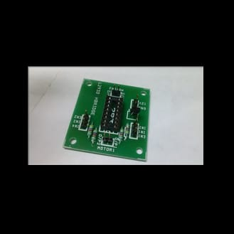
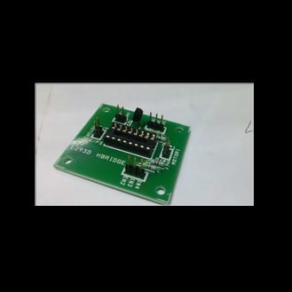
L293D MOTOR DRIVE

Slide 14
Features
The L293D is a popular motor driver IC that is usable from 6 to12V, at up to 1A total output current. By itself, the IC is somewhat difficult to wire and use, but the Compact L293D Motor Driver makes it much more convenient to use.
Board Special Features
• Four motor direction indicator LEDS
• Schottky EMF-protection diodes
• Socket pin connectors for easy logic interfacing
• Enable pins are user accessible.

Slide 15
MOTOR DRIVER CIRCUIT
The Device is a monolithic integrated high voltage, high current four channel driver.
Designed to accept standard DTL or TTL logic levels and drive inductive loads and switching power transistors.
We are using this driver circuit to drive the motors.
Each L293D is used to drive two motors.

Slide 16
MOTORS
NR-DC-ECO is high quality low cost DC geared motor. It contains Brass gears and steel pinions to ensure longer life and better wear and tear properties.
The gears are fixed on hardened steel spindles polished to a mirror finish. These spindles rotate between bronze plates which ensures silent running.
The output shaft rotates in a sintered bushing. The whole assembly is covered with a plastic ring.
All the bearings are permanently lubricated and therefore require no maintenance.
The motor is screwed to the gear box from inside.

Slide 17
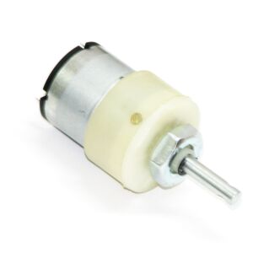
MOTORS
12v 100 rpm DC Geared Motor

Slide 18
Microcontroller
The main center part of the project is the microcontroller. Here we are using the 8051 based on P89V51RD2 microcontroller.
The P89V51RD2 are 80C51 microcontrollers with 64kB flash and 1024 B of data RAM.
The flash program memory supports both parallel programming and in serial In System Programming . Parallel programming mode offers gang-programming at high speed, reducing programming costs and time to market.
ISP allows a device to be reprogrammed in the end product under software control.
The capability to field/update the application firmware makes a wide range of applications possible

Slide 19
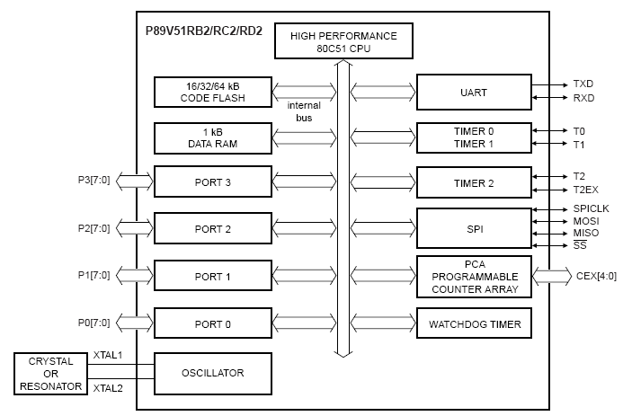
Block Diagram of Microcontroller

Slide 20
Features
80C51 CPU with 5V operating voltage from 0 to 40 MHz
64 kB of on-chip flash user code memory with ISP and IAP.
SPI and enhanced UART.
Four 8-bit I/O ports with three high-current port 1 pins.
Three 16-bit timers/counters.
Programmable watchdog timer.
Eight interrupt sources with four priority levels.
Second DPTR register
Low EMI mode (ALE inhibit)
TTL- and CMOS-compatible logic levels
Brownout detection
Low power modes
• Power-down mode with external interrupt wake-up
• Idle mode

Slide 21
List Of Modules
FUNCTIONING OF INTERNET OF THINGS (IOT)
FUTURE VISION OF INTERNET OF THINGS
• Things Oriented Vision
• Internet Oriented Vision
• Semantic Oriented Vision

Slide 22
Functioning of Internet of Things (IOT)
This article discusses the perspectives, challenges and opportunities behind a future Internet that fully supports the “things”, as well as how the things can help in the design of a more synergistic future Internet.
The worldwide network of interconnected computer networks based on a standard communication protocol, the Internet suite (TCP/IP) while a things is an object not precisely identifiable.
The world around us is full of objects, smart objects and the existing service provider known as Internet. The convergence of the sensors like smart objects, RFID based sensor networks and Internet gives rise to the Internet of Things.
With increased usage of sensors the raw data as well as distributed data is increasing. Smart devices are now connected to Internet using their communication protocol.

Slide 23
Functioning of Internet of Things (IOT)
Visualizing each sensor as having intelligence is the ultimate aim of any architecture in the IOT domain.
The objects that will be connected will be adaptive, intelligent, and responsive.
Overview of internet evolution with several IOT services with the use of radio-frequency identification (RFID) tags, sensors, actuators, mobile phones, smart embedded devices, etc.

Slide 24
FUTURE VISION OF INTERNET OF THINGS
The Internet of Things is a vision which is under development and there can be many stake holders in this development depending upon their interests and usage.
Sensor based data collection, data management, data mining and World Wide Web is involved in the present vision.
A variety of things or objects – such as Radio-Frequency Identification (RFID) tags, sensors, actuators, mobile phones, etc.
Through unique addressing schemes, are able to interact with each other and cooperate with their neighbors to reach common goals has been discussion on three particular visions.

Slide 25
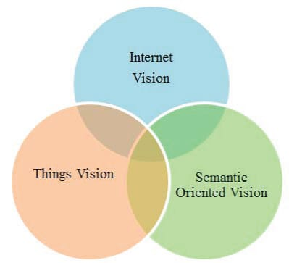
Three Main Visions of internet of things

Slide 26
Things Oriented Vision
This vision is supported by the fact that we can track anything using sensors and pervasive technologies using RFID. The basic philosophy is uniquely identifying any object using specifications of Electronic Product Code (EPC) . This technique is extended using sensors.
It is important to appreciate the fact that future vision will depend upon sensors and its capabilities to fulfill the “things” oriented vision.
The summarized vision will be dependent upon sensor based networks as well as RFID-based Sensor Networks which will take care.
Integration of technology is based on RFID and sophisticated sensing and computing devices and the global connectivity.

Slide 27
Internet Oriented Vision
The internet-oriented vision has pressed upon the need to make smart objects which are connected.
The objects need to have characteristics of IP protocols as this is one of the major
protocols being followed in the world of Internet. The sensor based object can be converted in to an understandable format, which can be identified uniquely and its attributes can be continuously monitored.
This makes the base for smart embedded objects which can be assumed to be a microcomputers having computing resources.

Slide 28
Semantic Oriented Vision
This vision is powered by the fact that the amount of sensors which will be available at our disposal will be huge and the data that they will collect will be massive in nature.
The raw data needs to be managed, processed and churned out in an understandable manner.
Wireless Sensor Networks hardware - Typically a WSN node contains interfaces to sensors, computing and processing units, transceiver units and power supply.
Wireless Sensor Networks Communication Stack (WSNCS) – The nodes will be deployed in an Adhoc manner.
Middleware–This is associated with the internet infrastructure and the concept of Service Oriented Architecture (SOA).

Slide 29
Communication Mechanism
All the objects that are present in the environment can be called object fit to be the “things” of the internet.
Internet Protocol is the standard based protocol which is used for internetworking methods of Internet.
Their communication mechanisms will be Wi-Fi, DSL, Satellite, Cable, Ethernet and so forth. The typical packet size of the communicating protocol will be around 1500 data bytes to 9000 data bytes and even more.
Thus entire network now forms a web of connectivity from users (high-level) to sensors (low-level) that is addressable (through URN) accessible (through URL) and controllable (through Uniform Resource Characteristics - URC)

Slide 30
Conclusion
Tongue Drive system (TDS) is a tongue-operated unobtrusive wireless assistive technology, which can potentially provide people with severe disabilities.
It has translated users intentions into control commands by detecting and classifying their voluntary tongue motion utilizing a small permanent magnet, secured on the tongue.
Array of magnetic sensors mounted on a headset outside the mouth and orthodontic brace inside.
We have developed customized interface circuitry and implemented four control strategies to drive a Powered Wheel Chair (PWC) using an external TDS prototype.

Slide 31
References:
[1] N.-H. White and N.-H. Black, "Spinal cord injury (SCI) facts and figures at a glance," National Spinal Cord Injury Center, 2016.
[2] M. Ghovanloo, M. Sahadat, Z. Zhang, F. Kong, N. Sebkhi, "Tapping into tongue motion to substitute or augment upper limbs", Proc. SPIE, vol. 10194, no. 1019413-1, May 2017.
[3] L.N.S.A. Struijk et al., "Development and functional demonstration of a wireless intraoral inductive tongue computer interface for severely disabled persons," Disability and Rehabilitation: Assistive Technology, pp. 1-10, Sep. 2016.
[4] X. Zhao, Y. Chu, J. Han, and Z. Zhang, "SSVEP-Based Brain–Computer Interface Controlled Functional Electrical Stimulation System for Upper Extremity Rehabilitation," IEEE Transactions on Systems, Man, and Cybernetics: Systems, vol. 46, pp. 947-956, 2016.
[5] J. Kim et al., "Qualitative assessment of tongue drive system by people with high-level spinal cord injury," Journal Rehab. Res. Dev., vol. 51, p. 451, May. 2014.

Slide 32
THANK YOU

